Slide 1



Urban Computation - a data driven and multiple dimensions approach
Nam LE, M.eng, PhD
1. Chair of Urban Risk and Resilience, UEH University | www.iscm.ueh.edu.vn
2. Director, Arcadis (Philippines and Indian offices) | www.arcadis.com
3. Founder, ASQ Vietnam Co. Ltd | www.asq.vn
4. Business Advisor, EMAPTA | www.emapta.com

Slide 2
Content
Bio of the speaker
Urban Computation
Asset Management, Risk and Resilience Analysis
Optimization
Interactive and data driven design and management approach focusing on multiple dimensions and multiple stakeholders
Integration vs Coordination (System of Systems)
Discussions
02
Work packages
Asset Management, Data Analytics and Offshore Staffing from Vietnam https://www.asq.vn
Institute of Smart City and Management https://www.iscm.ueh.edu.vn
Notes:
Định nghĩa trong luật Kiến trúc của Việt Nam

Slide 3






Bio of the Speaker
Prof. Kiyoshi Kobayashi
Kyoto University
Prof. Kiyoyuki Kaito
Osaka University
Prof. Bryan Adey
ETH Zurich
02
Work packages
2006-2009
2010
2010-2017
Asset Management, Data Analytics and Offshore Staffing from Vietnam https://www.asq.vn
Institute of Smart City and Management https://www.iscm.ueh.edu.vn
Notes:
Định nghĩa trong luật Kiến trúc của Việt Nam

Slide 4
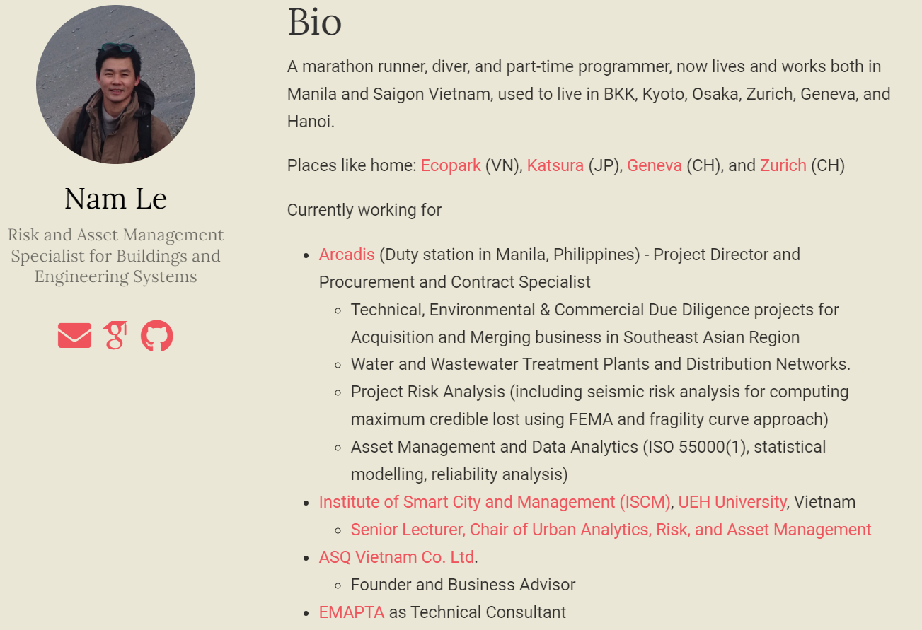
Bio of the Speaker
I am interested in applied mathematics, statistics, and operations research for optimal management and development of intervention strategies for buildings, infrastructure, and engineering systems.
Urban risk and resilience
Asset management for Buildings and Engineering Systems
Procurement Management
Data Analytics and Solutions
Website: https://namkyodai.github.io
Email: namlt@protonmail.com
Mobile: VN: +84-983780100 (Lines, Whatsapp, Viber, Zalo)
IN: +91-9810444723
02
Work packages
Asset Management, Data Analytics and Offshore Staffing from Vietnam https://www.asq.vn
Institute of Smart City and Management https://www.iscm.ueh.edu.vn
Notes:
Định nghĩa trong luật Kiến trúc của Việt Nam

Slide 5
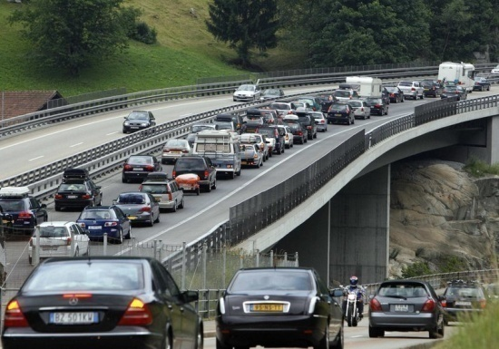





Asset Management
Road Networks
Water Supply Networks
Buildings
Rail Networks
Sewer Networks
Energy Distribution Networks
Asset Management, Data Analytics and Offshore Staffing from Vietnam https://www.asq.vn
Institute of Smart City and Management https://www.iscm.ueh.edu.vn
Notes:
Định nghĩa trong luật Kiến trúc của Việt Nam

Slide 6

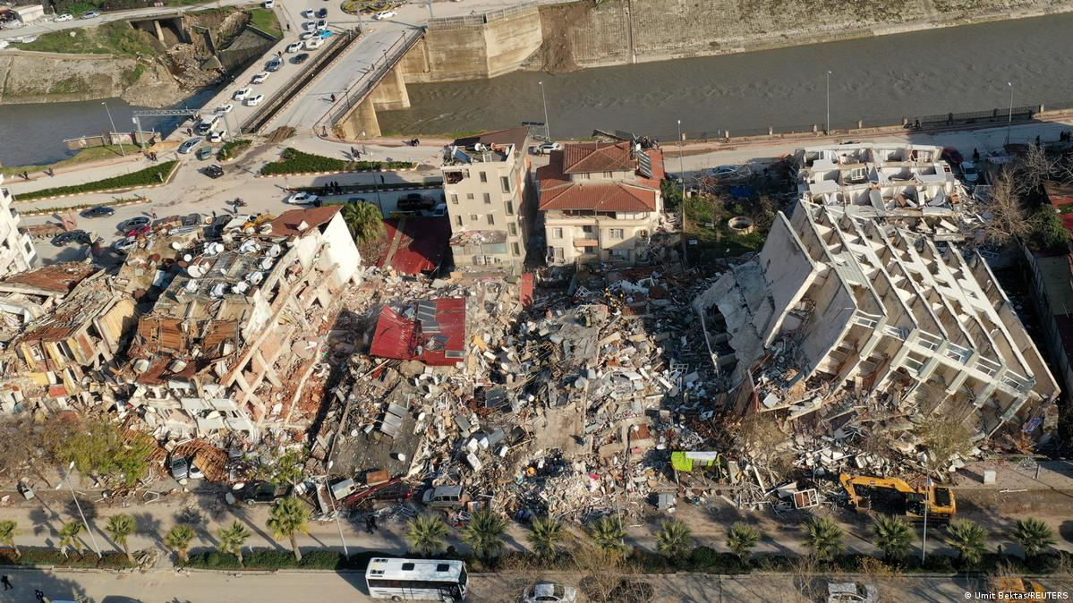
Deterioration Process
Manifest
If infrastructure deteriorates as expected
If infrastructure deteriorates due to unexpected events
Provided level of service
Processes
Models
Latent
Processes
Models
Asset Management, Data Analytics and Offshore Staffing from Vietnam https://www.asq.vn
Institute of Smart City and Management https://www.iscm.ueh.edu.vn
Notes:
Định nghĩa trong luật Kiến trúc của Việt Nam

Slide 7
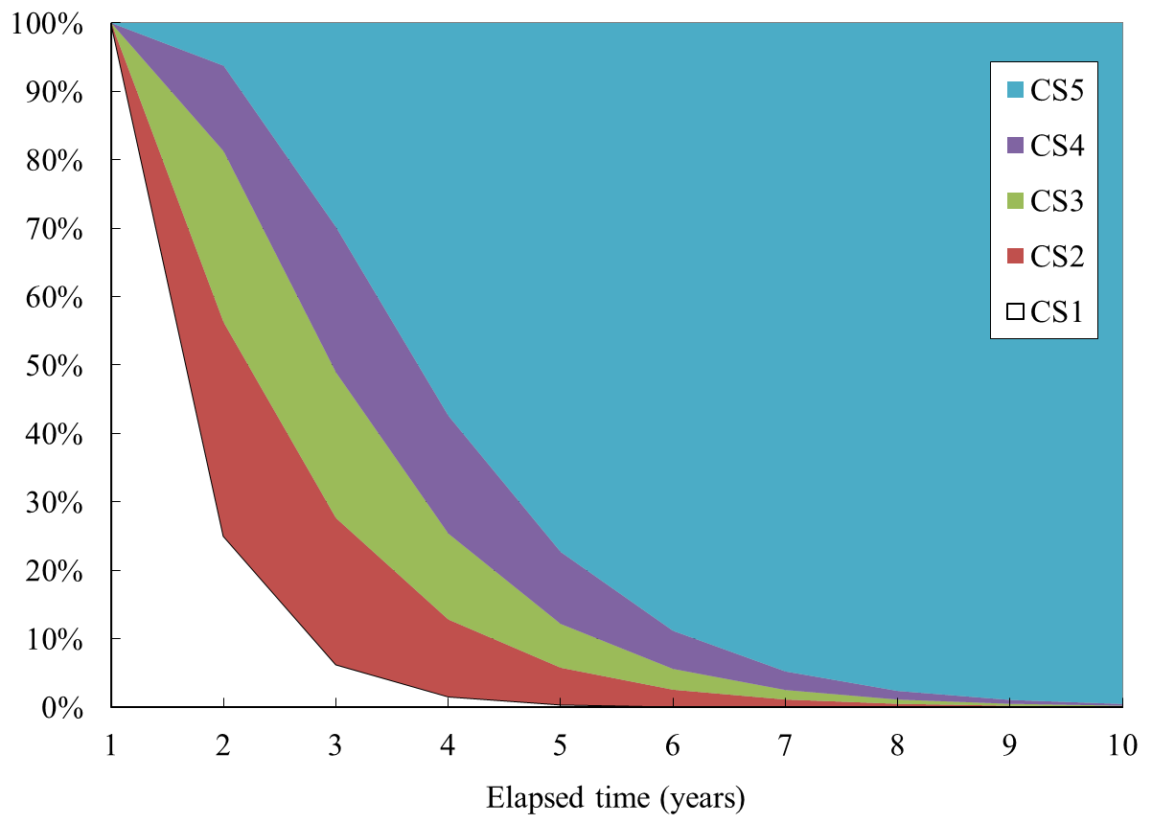
Level of Services
Level of Services (LOSs) are time dependent variable
Deterioration vs LOSs
Asset Management, Data Analytics and Offshore Staffing from Vietnam https://www.asq.vn
Institute of Smart City and Management https://www.iscm.ueh.edu.vn
Notes:
Định nghĩa trong luật Kiến trúc của Việt Nam

Slide 8
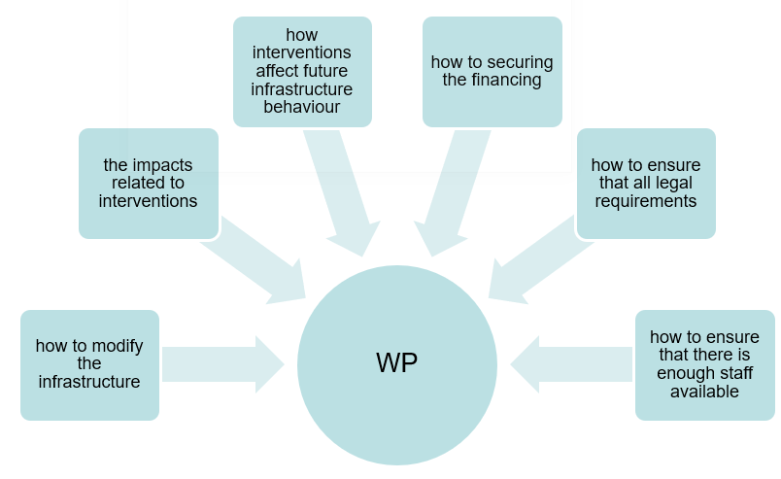
Impacts and Work Packages
Availability
Reliability
Maintainability
Total impacts
Asset Management, Data Analytics and Offshore Staffing from Vietnam https://www.asq.vn
Institute of Smart City and Management https://www.iscm.ueh.edu.vn
Notes:
Định nghĩa trong luật Kiến trúc của Việt Nam

Slide 9
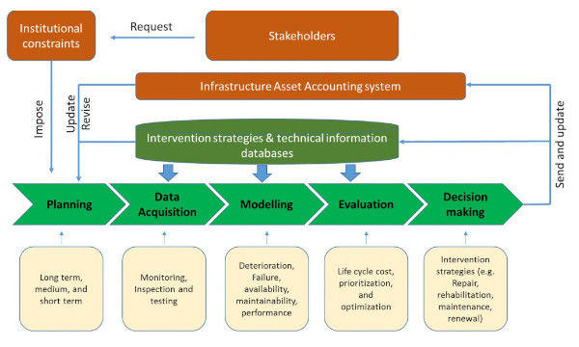
Asset Management
Asset Management is the optimal allocation of the scarce budget between the new arrangement of asset and rehabilitation/maintenance of the existing assets to maximize the value of the stock of assets and to realize the maximum outcomes for the stakeholders.
Asset Management, Data Analytics and Offshore Staffing from Vietnam https://www.asq.vn
Institute of Smart City and Management https://www.iscm.ueh.edu.vn
Notes:
Định nghĩa trong luật Kiến trúc của Việt Nam

Slide 10
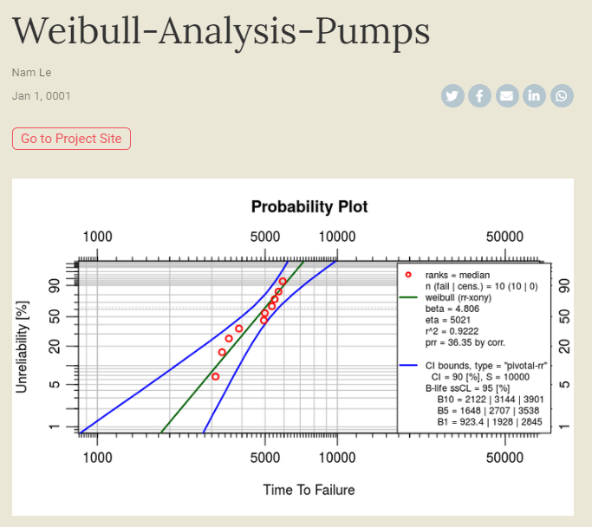
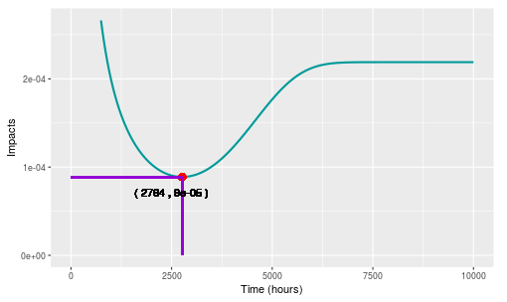
Optimization – Single Object
Example including deterioration prediction and cost optimization for a single object
https://namkyodai.github.io/apps/weibulllcc/
Asset Management, Data Analytics and Offshore Staffing from Vietnam https://www.asq.vn
Institute of Smart City and Management https://www.iscm.ueh.edu.vn
Notes:
Định nghĩa trong luật Kiến trúc của Việt Nam

Slide 11
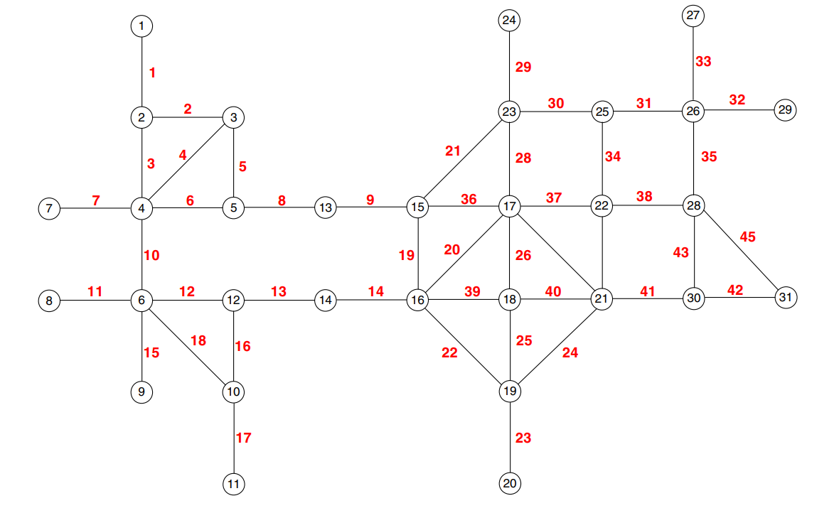
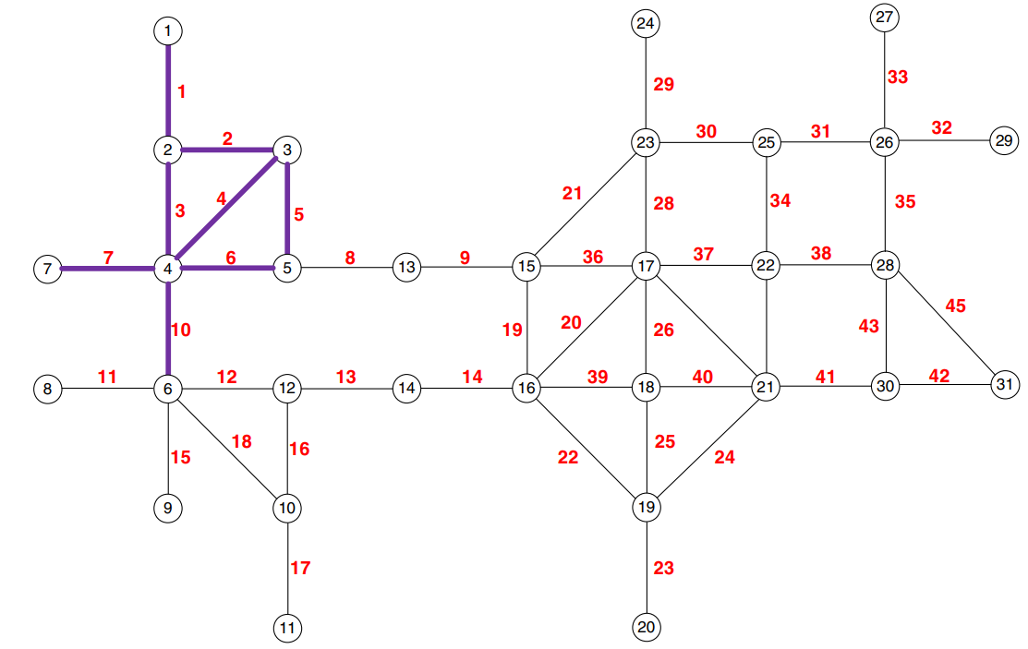
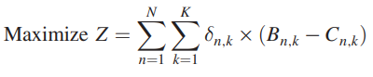
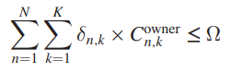
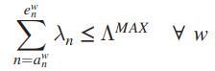
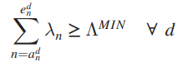
Optimization - Network
Determination of Optimal Work-zone in a large-scale network comprising of hundreds to thousand objects
Asset Management, Data Analytics and Offshore Staffing from Vietnam https://www.asq.vn
Institute of Smart City and Management https://www.iscm.ueh.edu.vn
Notes:
Định nghĩa trong luật Kiến trúc của Việt Nam

Slide 12
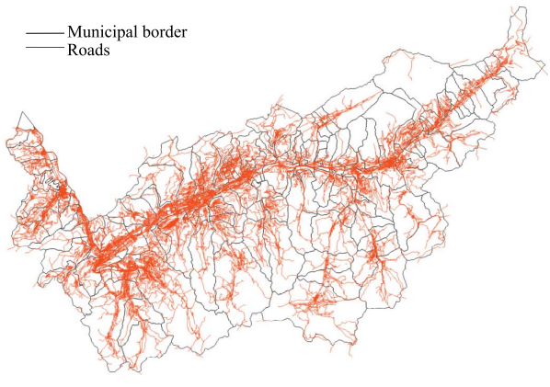
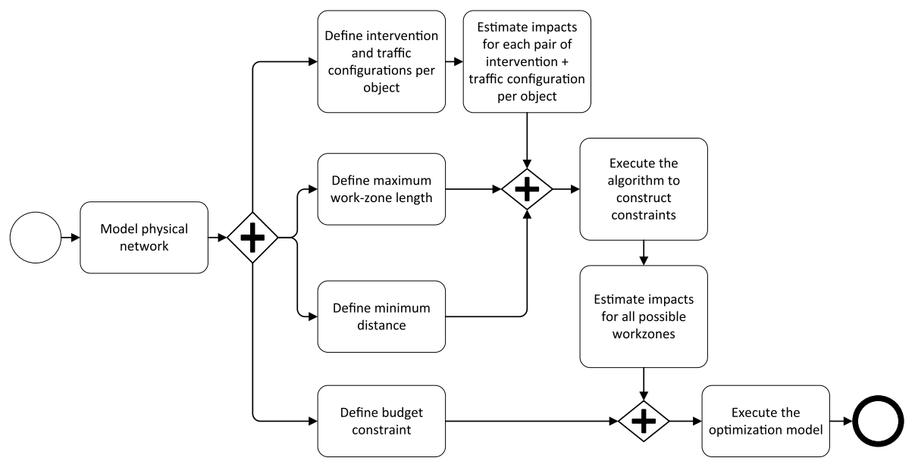
Optimization - Network
Asset Management, Data Analytics and Offshore Staffing from Vietnam https://www.asq.vn
Institute of Smart City and Management https://www.iscm.ueh.edu.vn
Notes:
Định nghĩa trong luật Kiến trúc của Việt Nam

Slide 13
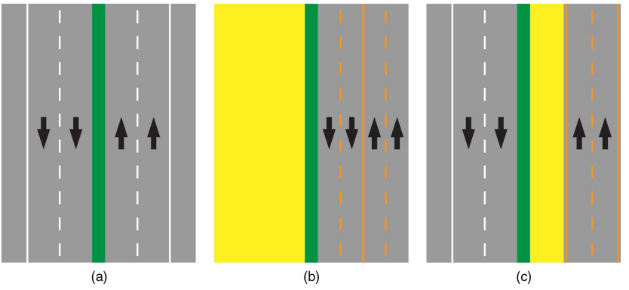
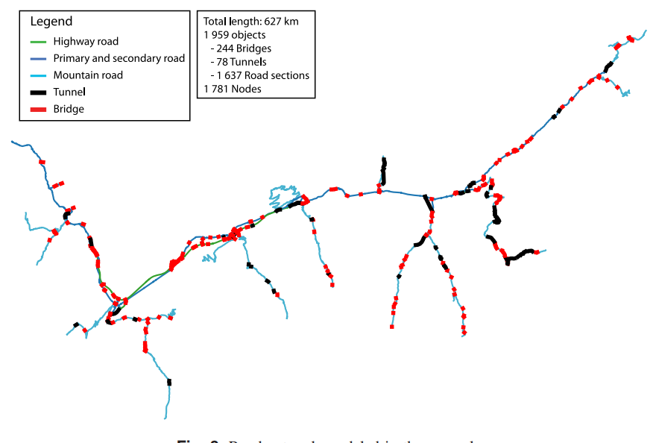
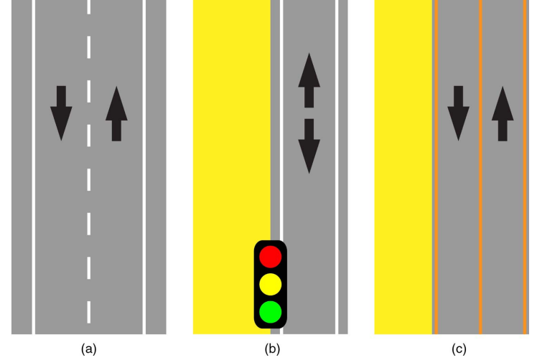
Optimization - Network
Asset Management, Data Analytics and Offshore Staffing from Vietnam https://www.asq.vn
Institute of Smart City and Management https://www.iscm.ueh.edu.vn
Notes:
Định nghĩa trong luật Kiến trúc của Việt Nam

Slide 14
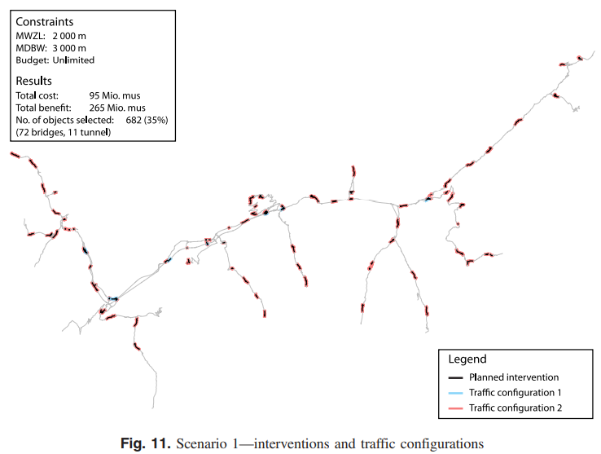
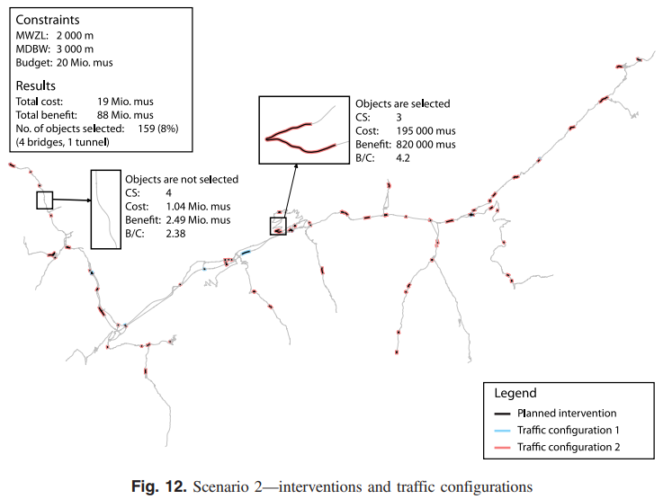
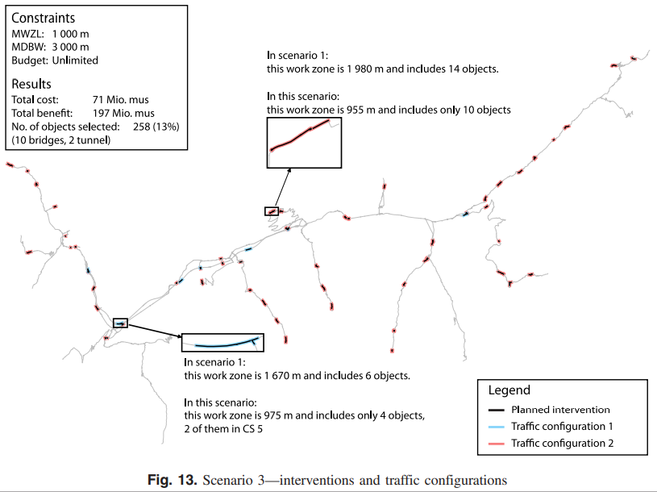
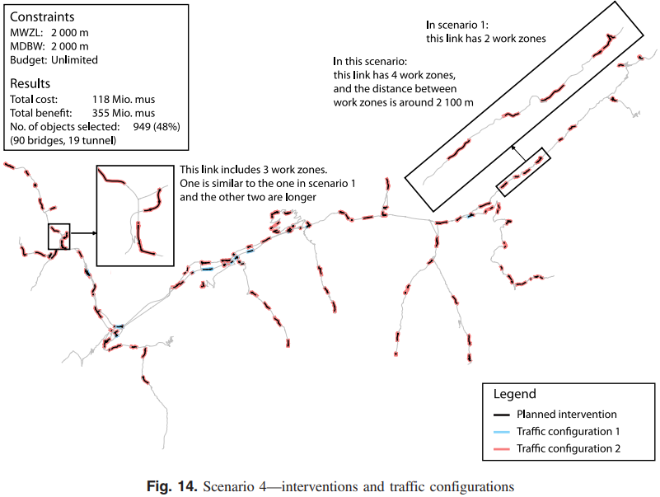
Optimization - Network
4 different scenarios were generated.
The optimal intervention program can be recommended based on the objective function and constraints
Asset Management, Data Analytics and Offshore Staffing from Vietnam https://www.asq.vn
Institute of Smart City and Management https://www.iscm.ueh.edu.vn
Notes:
Định nghĩa trong luật Kiến trúc của Việt Nam

Slide 15
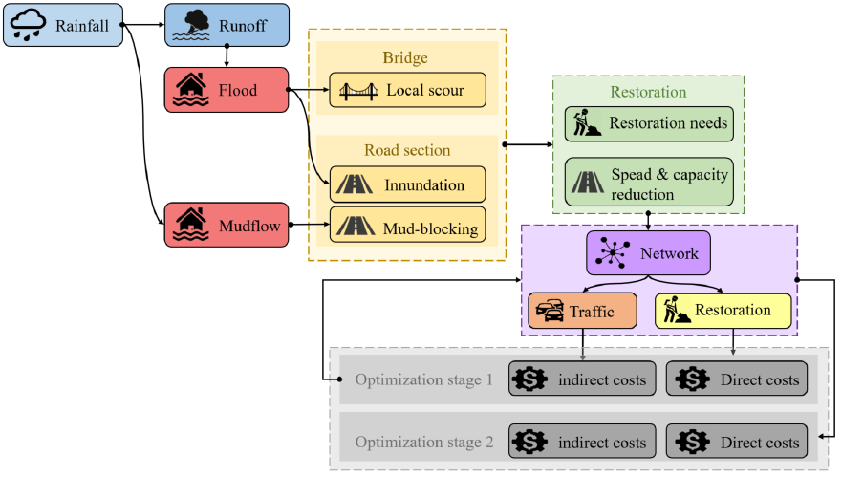
Risk and Resilience Management
Infrastructure assets might be damaged and destroyed severely and scattered geographically.
It requires significant volume of budget that needs to be mobilized in a short time window.
Different affected areas require different level of attention due to aspects such as politics, military, economic, education, environment etc.
The readiness and capability of local governments and organizations (e.g. military force, local union, equipment, volunteer, and companies).
The stability and resilience level required by the restoration activities, especially in the period of having uncertainty in coming disaster events.
Restoration modelling requires a well-established way of quantification of risks and resilience as well as a sound optimization engine.
Asset Management, Data Analytics and Offshore Staffing from Vietnam https://www.asq.vn
Institute of Smart City and Management https://www.iscm.ueh.edu.vn
Notes:
Định nghĩa trong luật Kiến trúc của Việt Nam

Slide 16

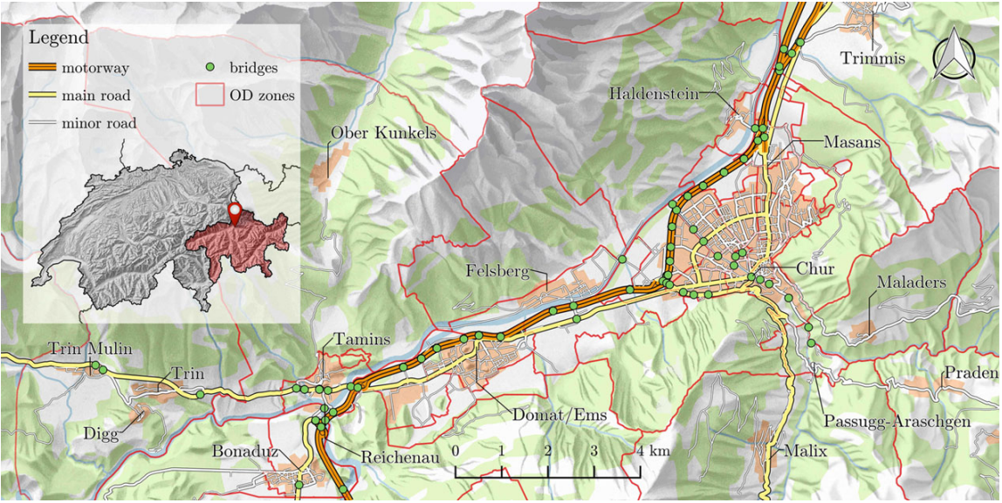
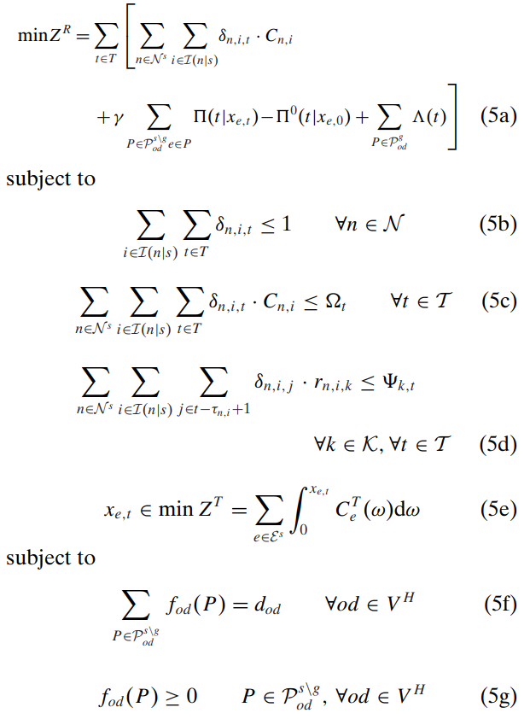
Risk and Resilience Management
Rain → Flood → Impact on Critical Infrastructure → Time of the Impact → Response Strategies
Prediction
Estimation
Optimization
Cloud Computing
Asset Management, Data Analytics and Offshore Staffing from Vietnam https://www.asq.vn
Institute of Smart City and Management https://www.iscm.ueh.edu.vn
Notes:
Định nghĩa trong luật Kiến trúc của Việt Nam

Slide 17
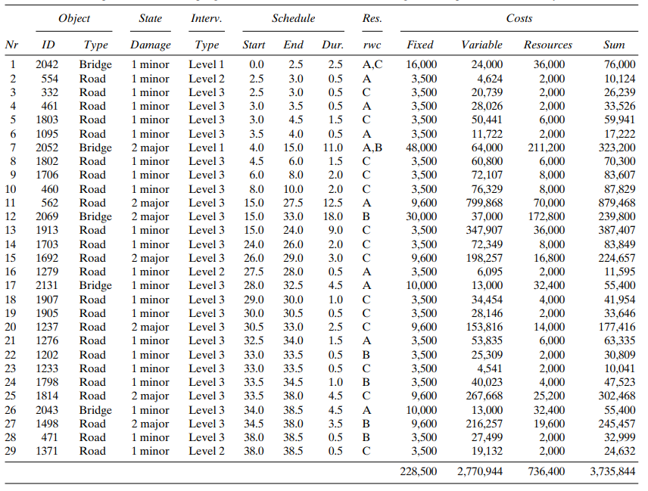
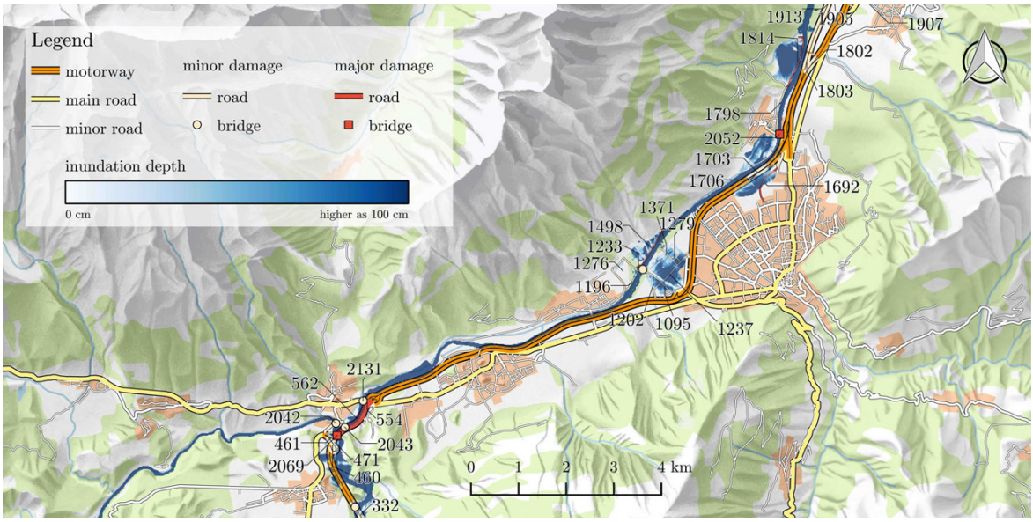
Risk and Resilience Management
Rain → Flood → Impact on Critical Infrastructure → Time of the Impact → Response Strategies
Prediction
Estimation
Optimization
Cloud Computing
Asset Management, Data Analytics and Offshore Staffing from Vietnam https://www.asq.vn
Institute of Smart City and Management https://www.iscm.ueh.edu.vn
Notes:
Định nghĩa trong luật Kiến trúc của Việt Nam

Slide 18
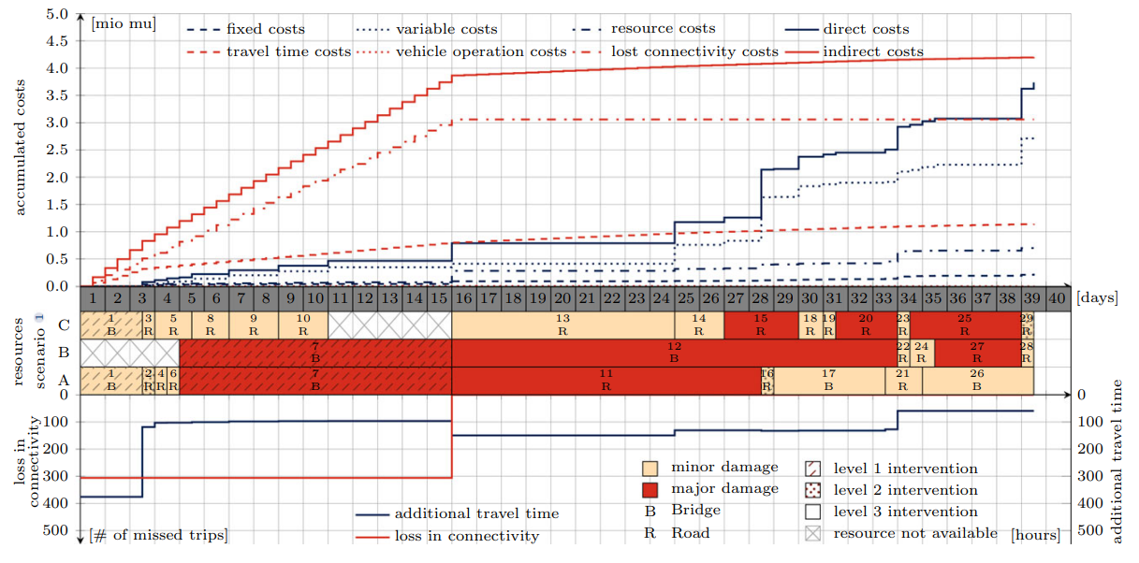
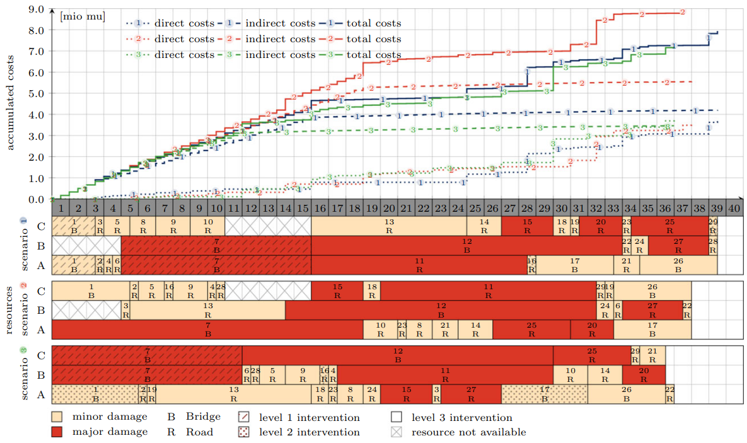
Risk and Resilience Management
Benefits of different restoration scenarios are generated for the purpose of optimal decision making.
Events and restoration scenarios can be simulated in advance.
Asset Management, Data Analytics and Offshore Staffing from Vietnam https://www.asq.vn
Institute of Smart City and Management https://www.iscm.ueh.edu.vn
Notes:
Định nghĩa trong luật Kiến trúc của Việt Nam

Slide 19

Data Driven and Multiple dimensions (1)
Urban design and management practice is undergoing a drastically change toward quantitative, digital based, and performance-based approach
2 D
3 D
> 3 D (BIM)
Digital Twin
Stakeholders of an Urban Megacity need to be engaged in design and planning for their city, not only for a short time. The city needs to be designed and managed to be livable and sustainable.
02
Work packages
Source: https://www.esri.com/
Asset Management, Data Analytics and Offshore Staffing from Vietnam https://www.asq.vn
Institute of Smart City and Management https://www.iscm.ueh.edu.vn
Notes:
Định nghĩa trong luật Kiến trúc của Việt Nam

Slide 20
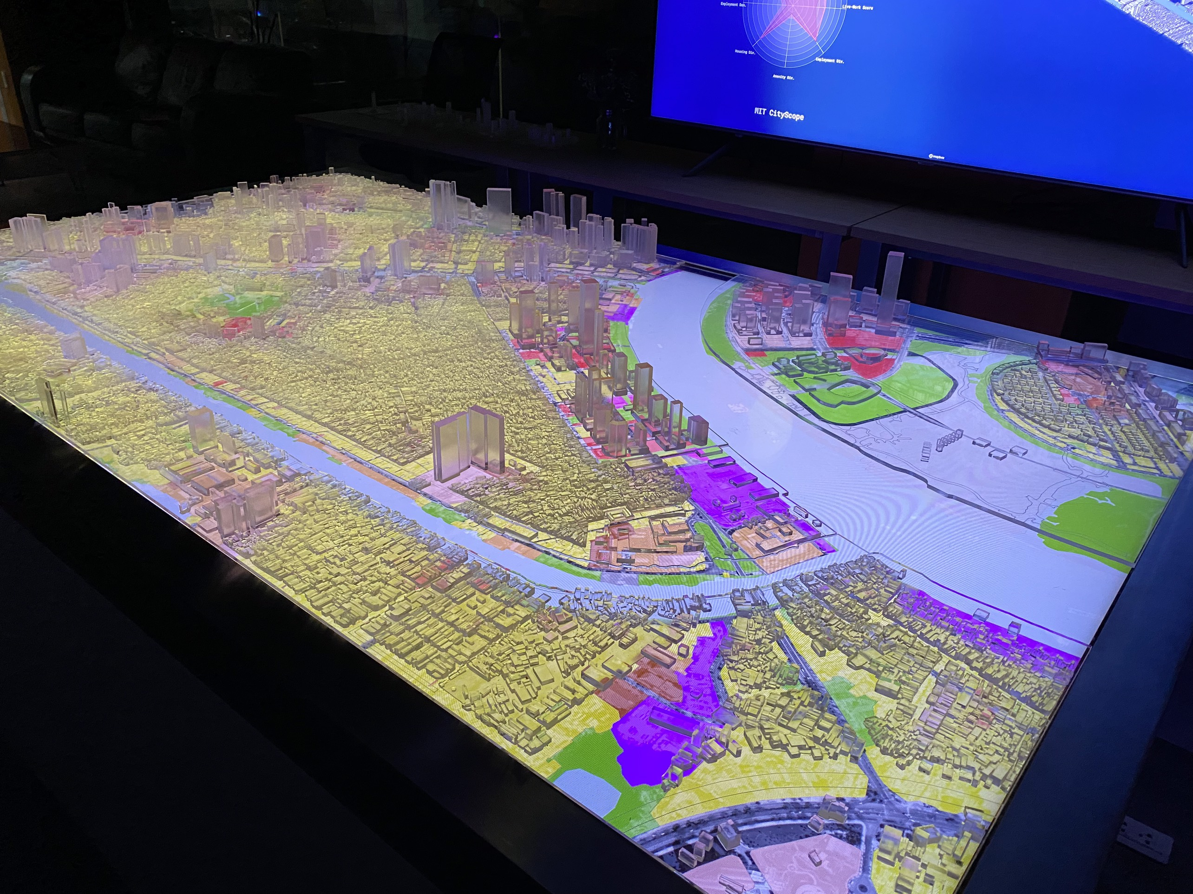
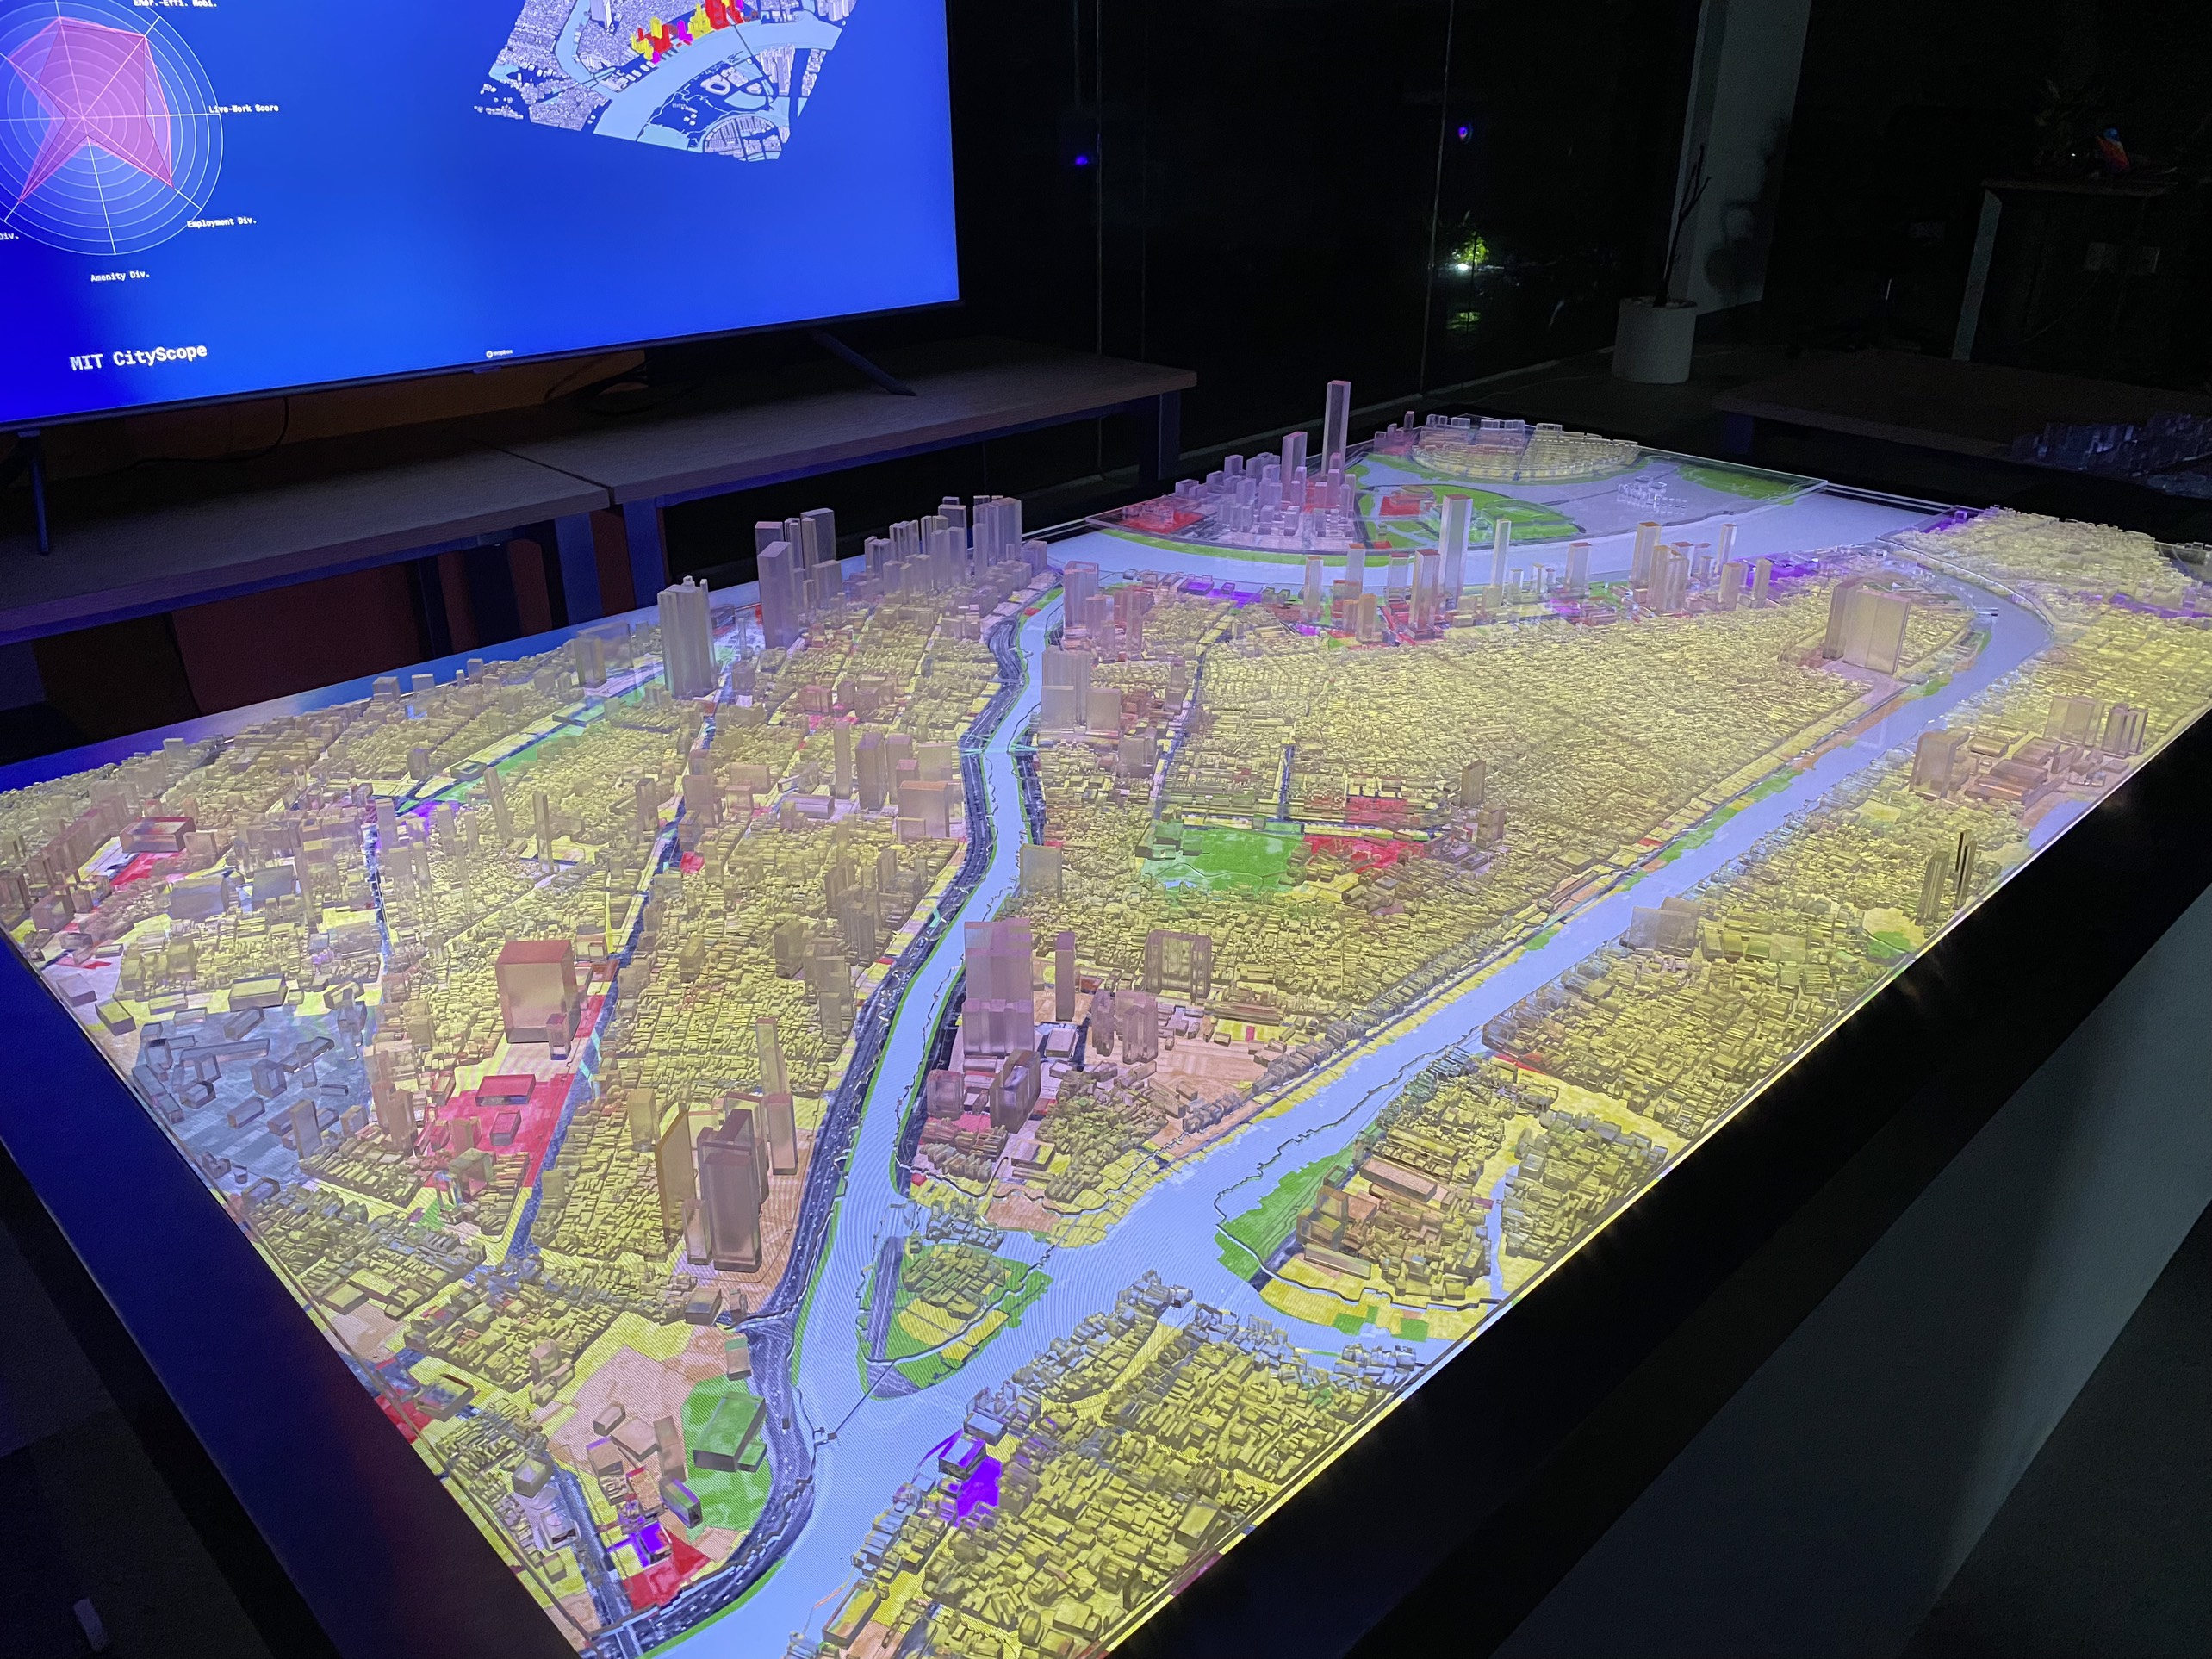
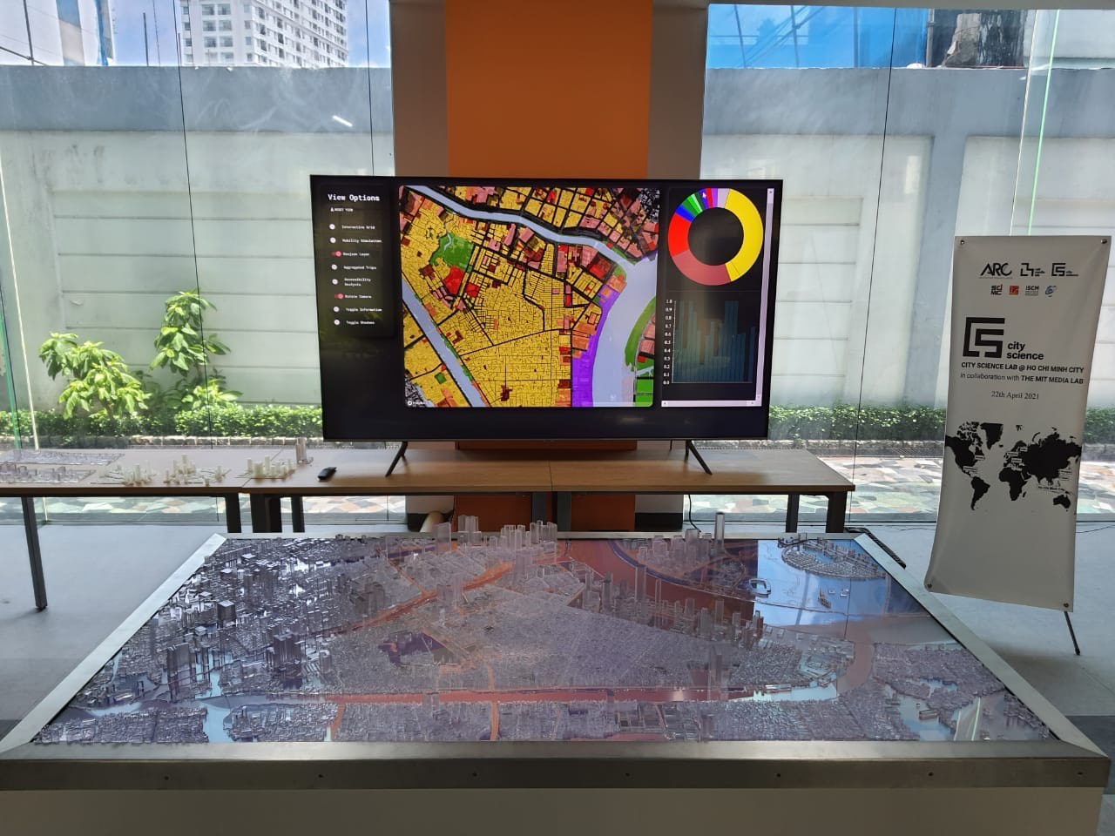
Data Driven and Multiple dimensions (2)
A digital and tangible platform enabling multiple stakeholders to interactively engage in design and planning of their cities. Key urban indicators are updated and visualized.
Proximity
Diversity
Density
Gentrification
Agent-based models and spatial analysis
Asset Management, Data Analytics and Offshore Staffing from Vietnam https://www.asq.vn
Institute of Smart City and Management https://www.iscm.ueh.edu.vn
Notes:
Định nghĩa trong luật Kiến trúc của Việt Nam

Slide 21
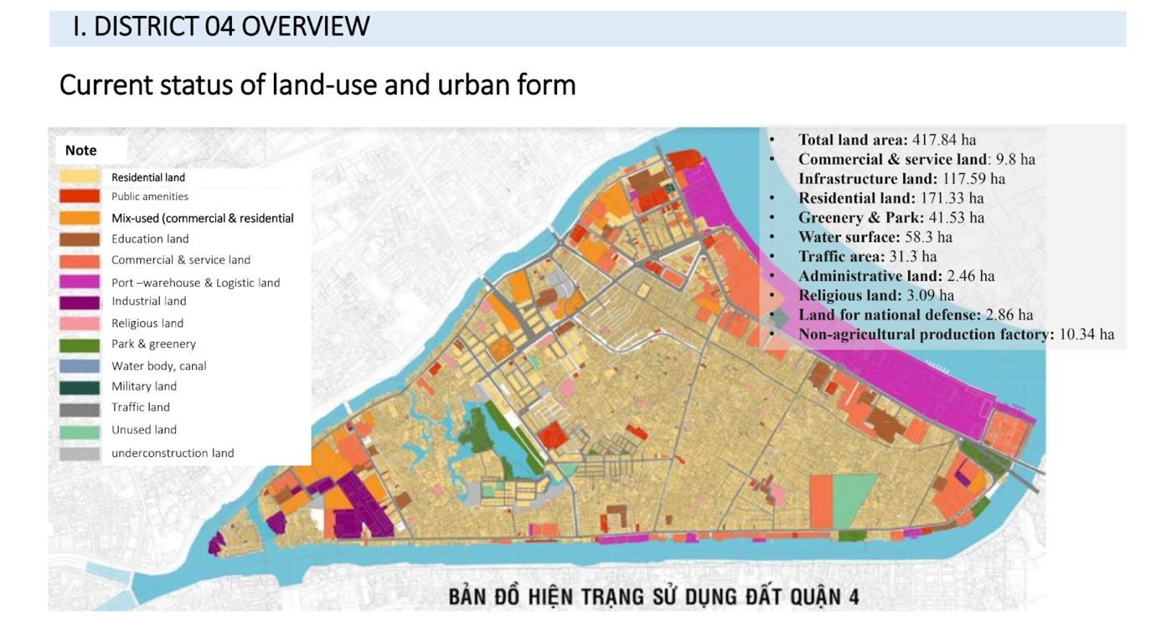
Example in District 4 – HCMC (1)
Developing a list of key urban indicators using available spatial data
Constructing a physical table for interaction
Building algorithm to enable the interaction with the physical table and with computers.
Demonstration of useability and applicability to policy makers
Discussion for scaling up the model and table
Consideration of risk and resilience in future model
Asset Management, Data Analytics and Offshore Staffing from Vietnam https://www.asq.vn
Institute of Smart City and Management https://www.iscm.ueh.edu.vn
Notes:
Định nghĩa trong luật Kiến trúc của Việt Nam

Slide 22
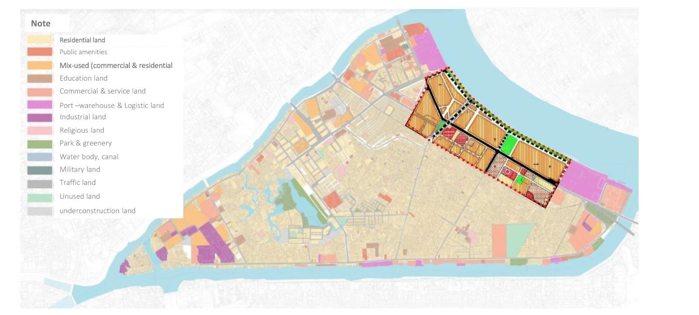
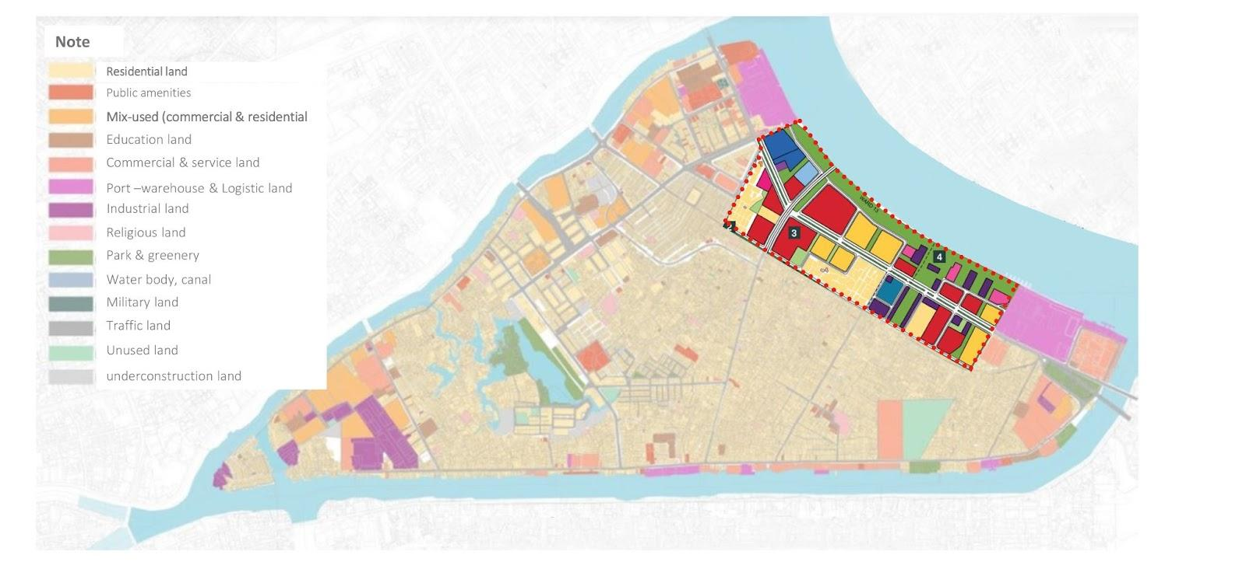
Example in District 4 – HCMC (2)
Scenario 1
Scenario 2
Scenario 3
Scenario | Description | Remarks
1 | No change in current layout
2 | Change according to approved master plan | Nguyen Tat Thanh st is expanded toward Saigon river Current Saigon Port to be converted to be multiple purpose area with dense office and commercial buildings to be constructed
3 | Similar to scenario 2 but with adjustment on the functional use. | Increase green area Change in occupancy of buildings by increase building highs
Asset Management, Data Analytics and Offshore Staffing from Vietnam https://www.asq.vn
Institute of Smart City and Management https://www.iscm.ueh.edu.vn
Notes:
Định nghĩa trong luật Kiến trúc của Việt Nam

Slide 23
Example in District 4 – HCMC (3)
Main Indicator | Sub-indicator
Density | Population, House, Amenity, Employment,
Diversity | House, Amenity, Employment, Income
Accessibility | Amenity, Employment, Residential
Live-Work Balance
Mobility | Energy-Efficiency
Required extensive spatial data with predictive models
Population (historical data and forecasting data using regression and interpolation models)
Point of Interest (POI)
O-D Matrix and transportation network analysis
Land-use
Distribution of income, amenity, housing etc.
Asset Management, Data Analytics and Offshore Staffing from Vietnam https://www.asq.vn
Institute of Smart City and Management https://www.iscm.ueh.edu.vn
Notes:
Định nghĩa trong luật Kiến trúc của Việt Nam

Slide 24
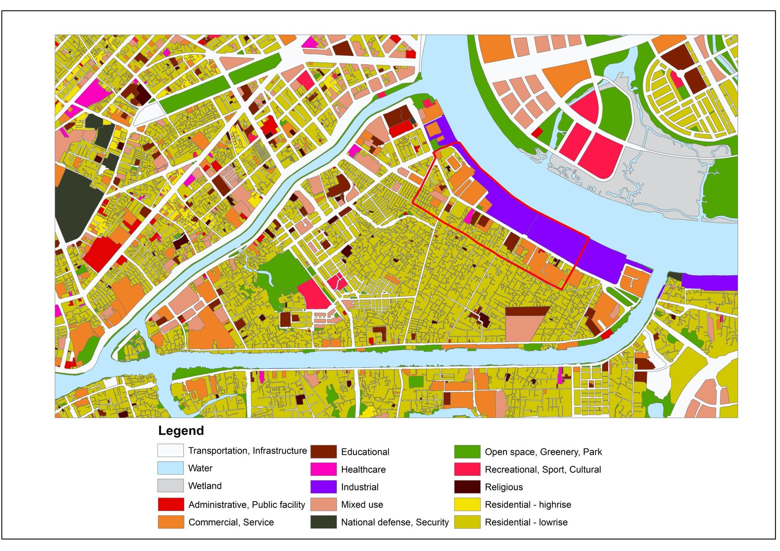
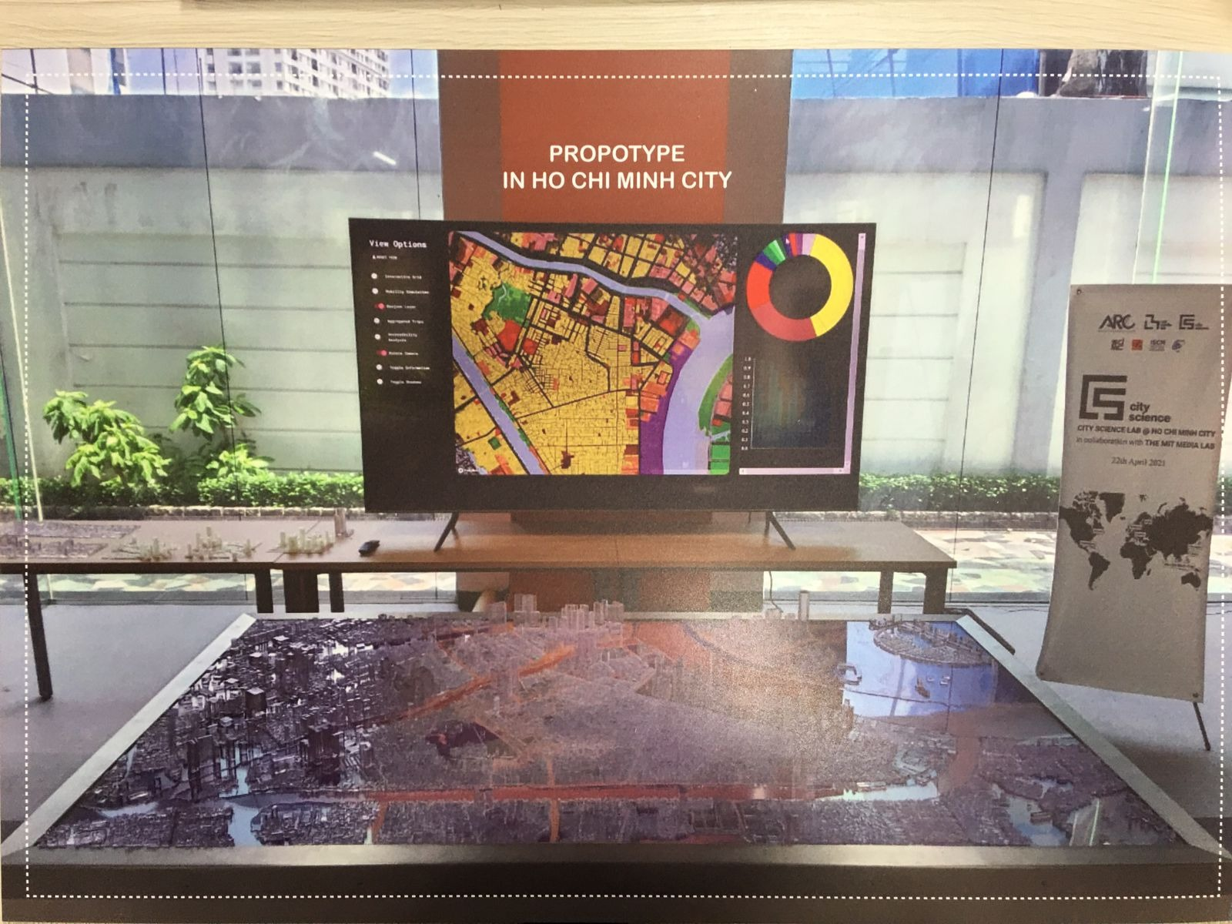
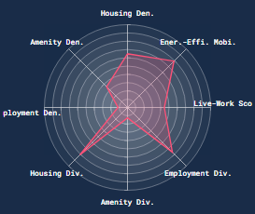
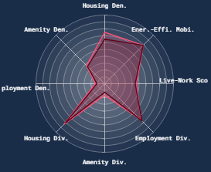
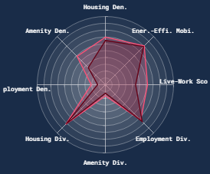
Example in District 4 – HCMC (4)
Asset Management, Data Analytics and Offshore Staffing from Vietnam https://www.asq.vn
Institute of Smart City and Management https://www.iscm.ueh.edu.vn
Notes:
Định nghĩa trong luật Kiến trúc của Việt Nam

Slide 25
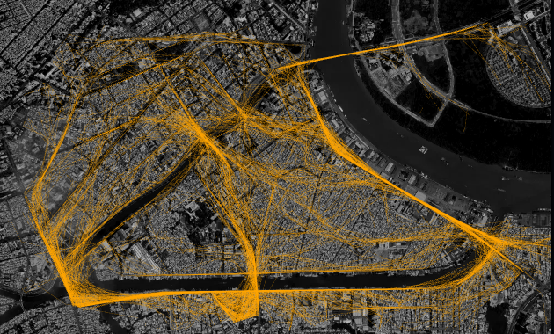
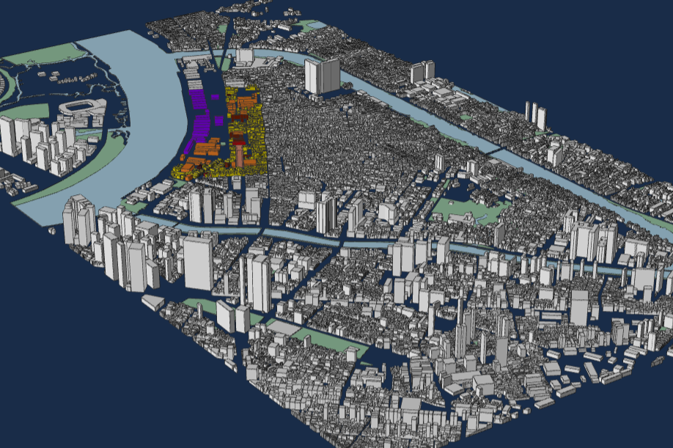
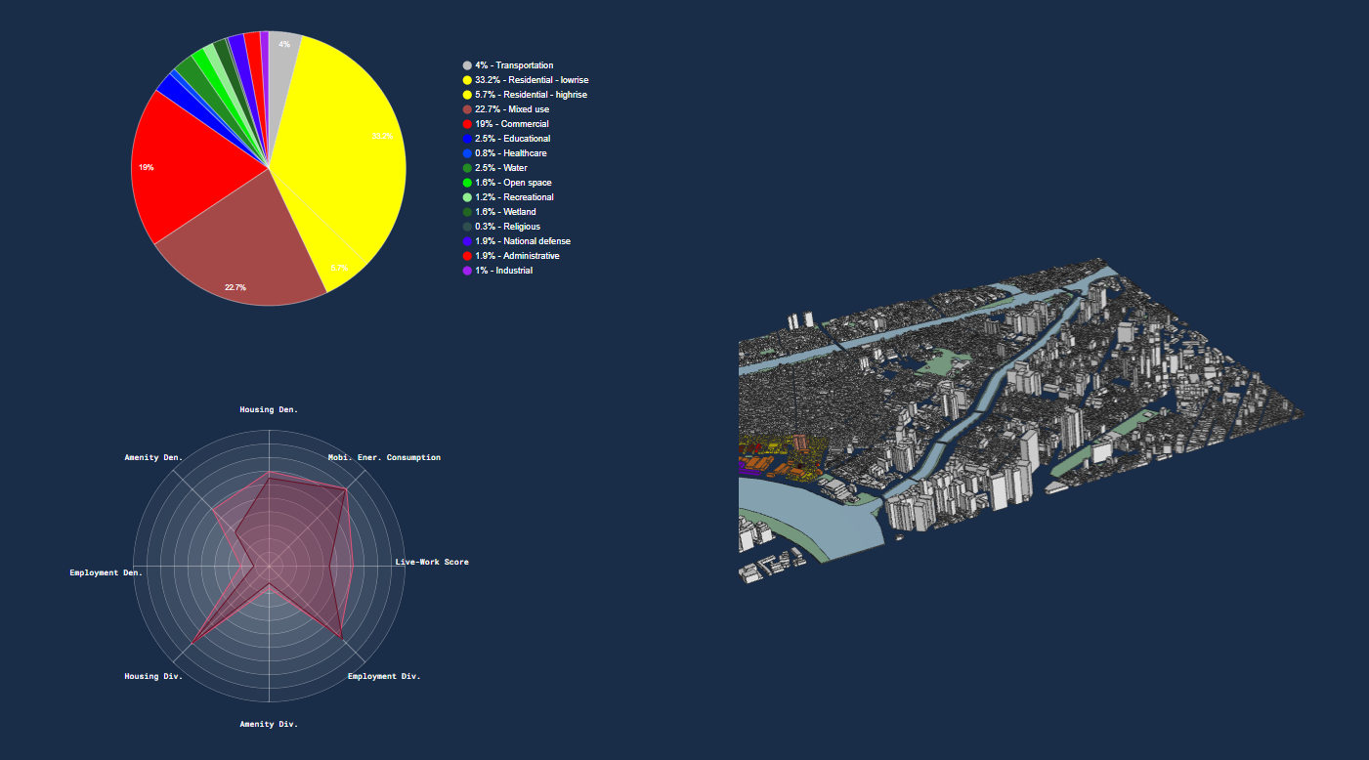
Example in District 4 – HCMC (5)
Asset Management, Data Analytics and Offshore Staffing from Vietnam https://www.asq.vn
Institute of Smart City and Management https://www.iscm.ueh.edu.vn
Notes:
Định nghĩa trong luật Kiến trúc của Việt Nam

Slide 26


Integration vs Coordination
System Integration (Optimization), AI, Big Data, Boundary of System
System of Systems (Coordination)
Super Apps
Asset Management, Data Analytics and Offshore Staffing from Vietnam https://www.asq.vn
Institute of Smart City and Management https://www.iscm.ueh.edu.vn
Notes:
Định nghĩa trong luật Kiến trúc của Việt Nam

Slide 27
Discussion, Q&A
Asset Management, Data Analytics and Offshore Staffing from Vietnam https://www.asq.vn
Institute of Smart City and Management https://www.iscm.ueh.edu.vn
Notes:
Định nghĩa trong luật Kiến trúc của Việt Nam

